Slide 1

ScanShot: Detecting Document Capture Moments and Correcting Device Orientation
Jeungmin Oh, Woohyeok Choi, Joohyun Kim, Uichin Lee
(Dept. of Knowledge Service Engineering, KAIST)
Notes:
- (Thanks, session chair for introducing me. )
- Good morning. I'm Jeungmin Oh, a Ph.D. candidate from dept. of knowledge service engineering in KAIST.
- I’m glad to be here to present ScanShot which deals with erroneous orientation when capturing document using smartphone built-in camera.
- Co-authors are Woohyeok Choi, Joohyun Kim, and my advisor, Prof. Uichin Lee.

Slide 2
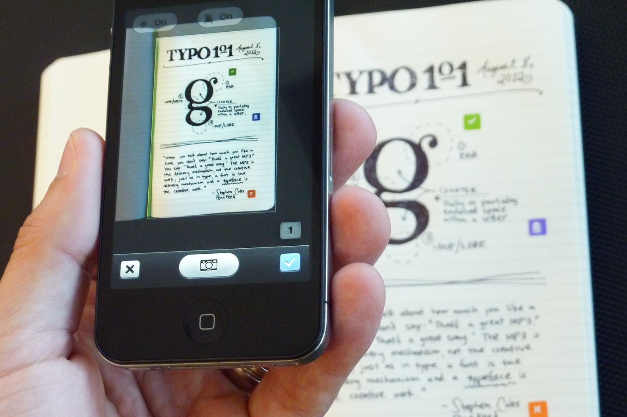
Document capturing using a smartphone camera becomes very common
Notes:
We often take photos of documents in order to digitize our own note-takings or memorable parts (pause) as in this photo.

Slide 3



Many apps support document capturing, however…
Notes:
- There are many mobile apps specialized in information capturing such as Scannable from Evernote or Office Lens recently announced by Microsoft.
- These apps help document capturing with a variety of functions, for example, cropping, correcting perspectives, resizing, and controlling contrast.
- Surprisingly, those apps have critical problem when we capturing a document.

Slide 4
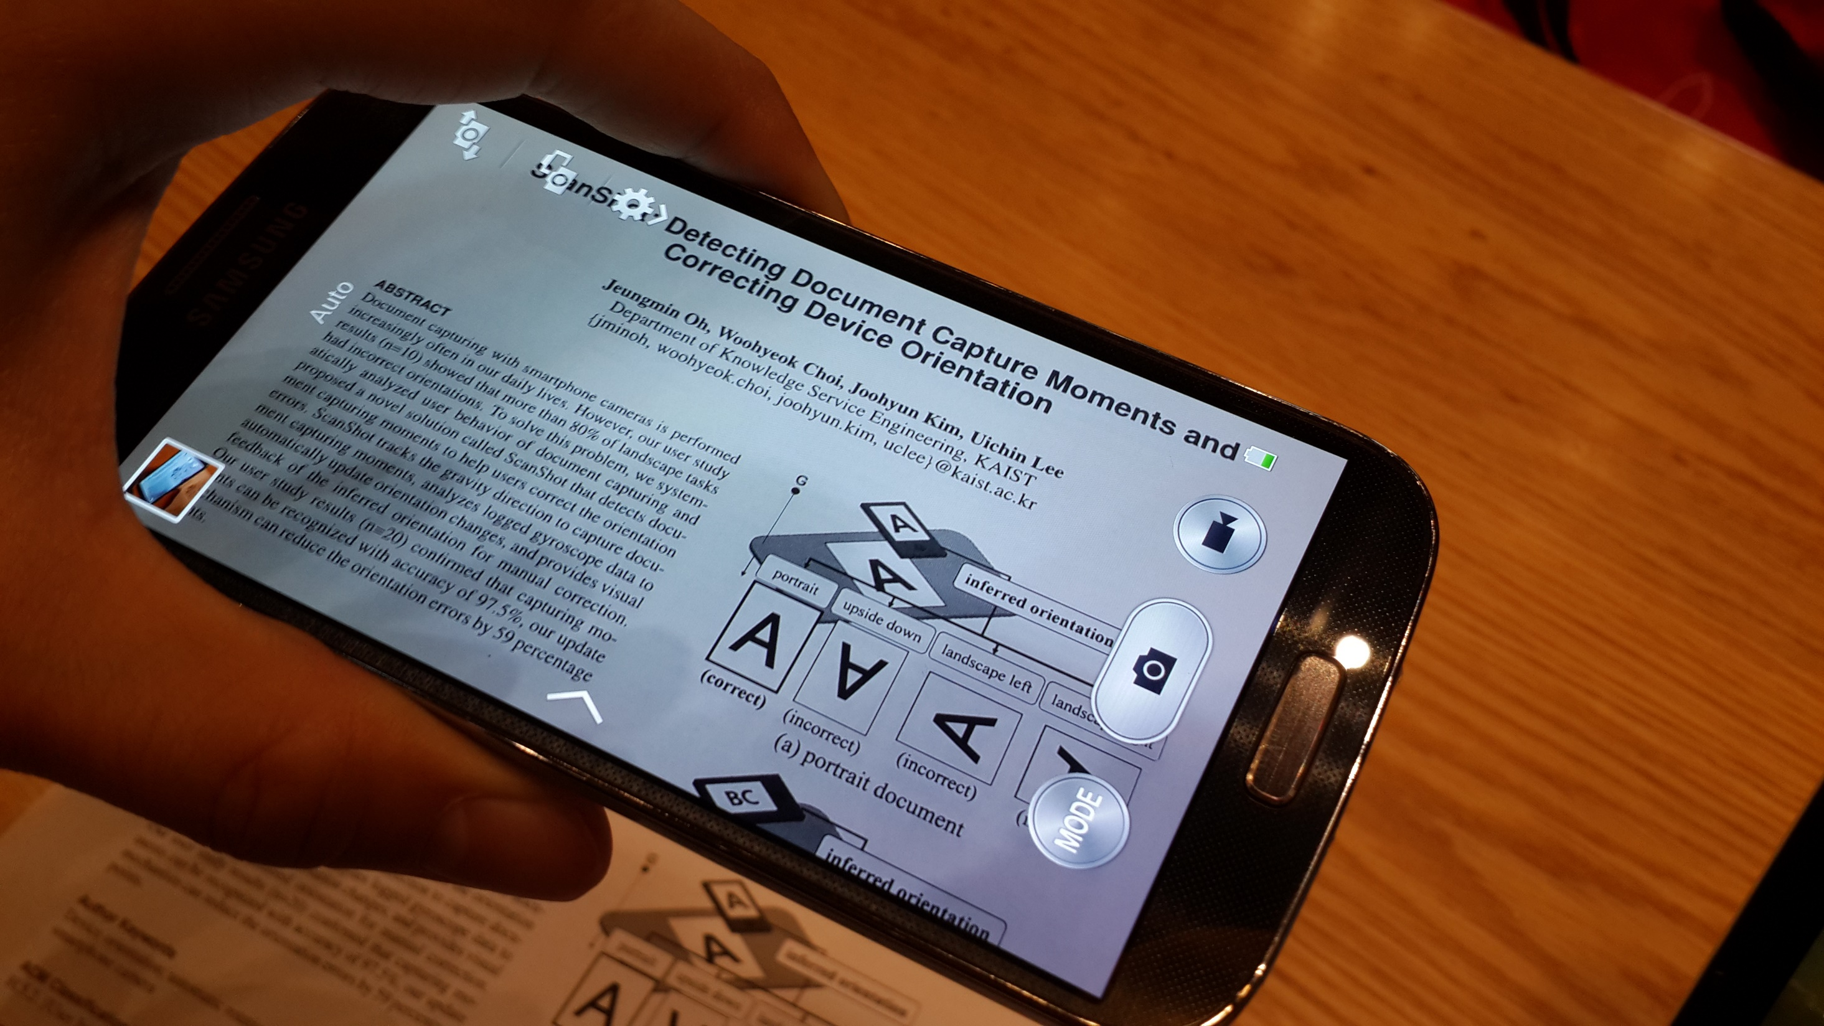
Capturing a document
If we take a photo of document…
Notes:
To demonstrate what the problem is, let’s take a photo of a document.

Slide 5
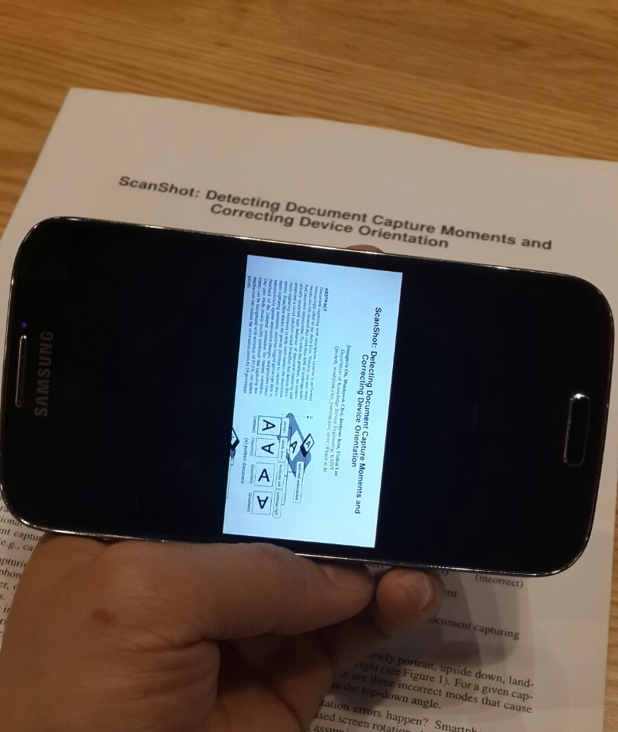
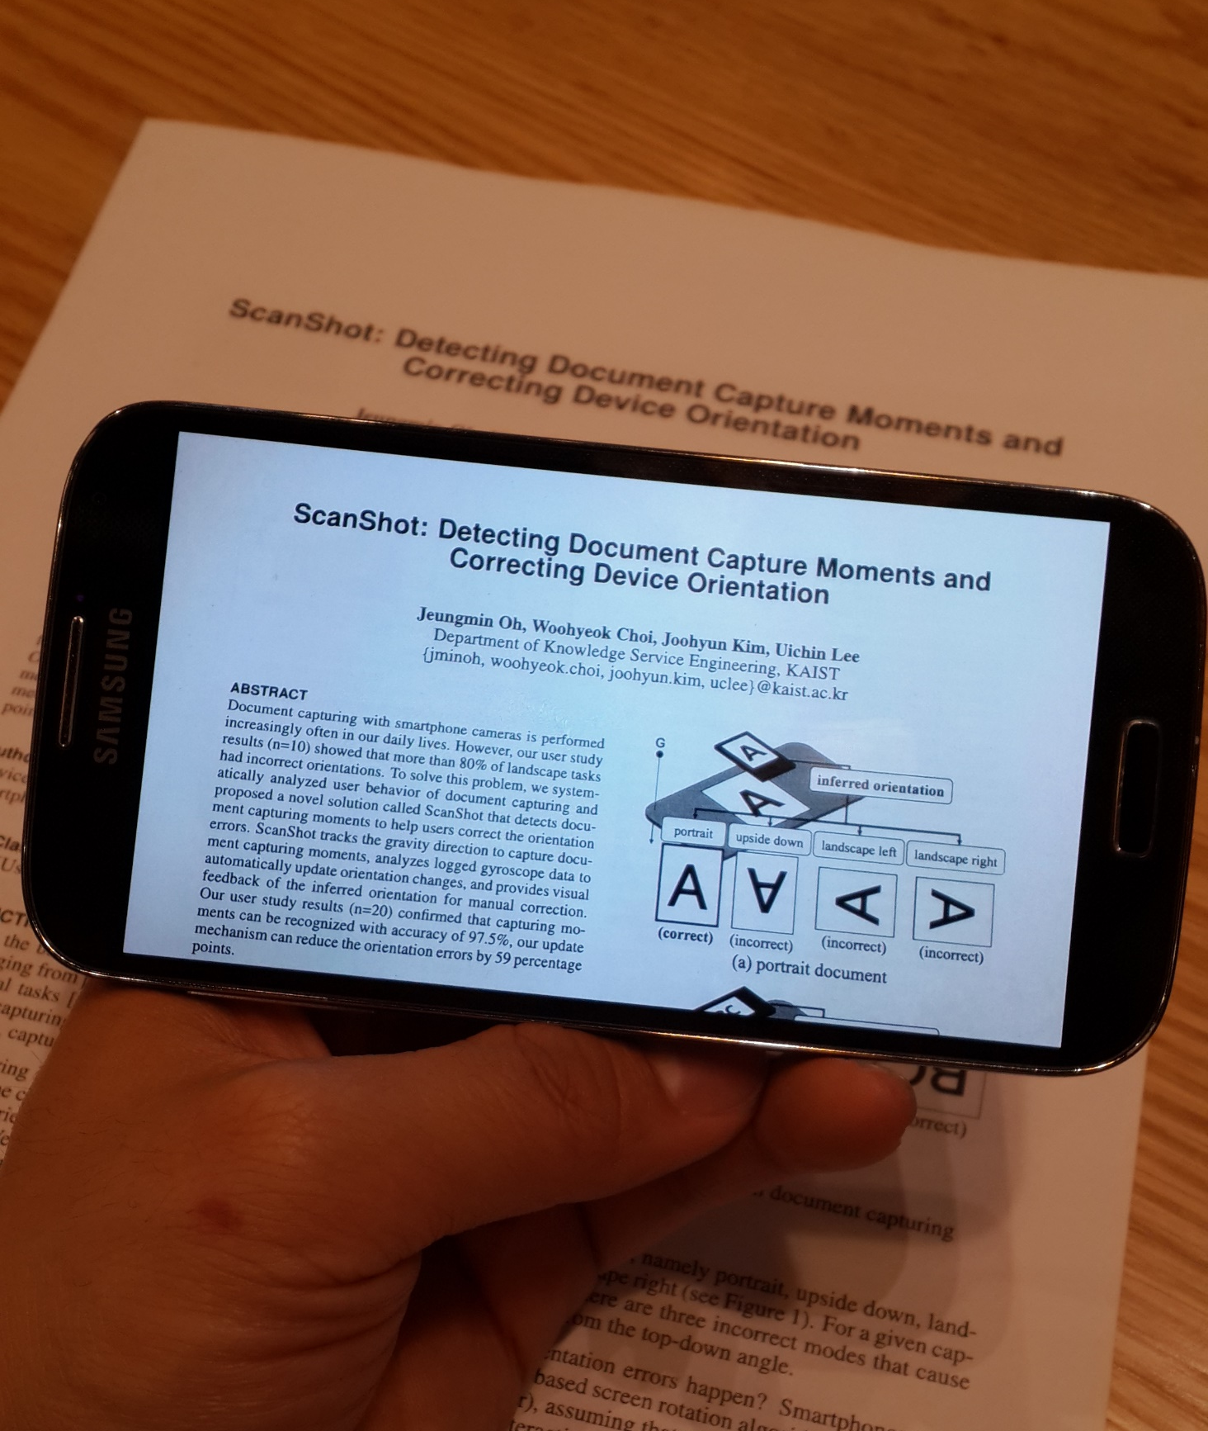
Viewing a captured document
Occasionally, captured photos had
with erroneous orientation
Notes:
- Occasionally, photos are taken with an erroneous orientation as shown in photos.
- (Pointing the slide) The photo on left side is the expected result with correct orientation. However, the right photo is captured with wrong orientation.
- The goal of our research is to solve the erroneous orientation issue when we capturing a document by understanding the problem.

Slide 6
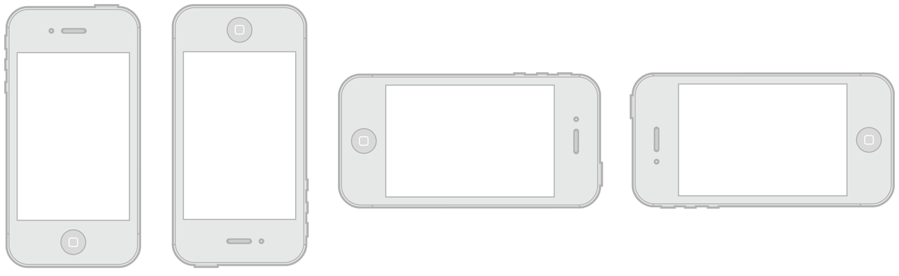
Why do such orientation errors happen?
Upside Down
Portrait
Landscape Right
Landscape Left
Notes:
- Why do such orientation errors happen?
- As shown in the slide, there are four possible orientations for smartphones, unless the app developer restrict the orientation changes.

Slide 7
Why do such orientation errors happen?
Notes:
- In document capturing situation, the system fails to calculate orientation properly.
- This is because the device is commonly located perpendicular to the direction of gravity while we capturing a document (on the desk).
- The orientation easily changes to arbitrary orientation modes due to user’s momentary movement or tilt.

Slide 8


We ran photo taking experiment…
Notes:
- An experiment with 16 people was conducted to understand severity of the problem and find solution using built-in sensors.
- We marked 20 parts using sticky note, and let the users to capture the marked area as usual using smartphone camera.
- We also collected accelerometer and gyroscope data.

Slide 9
The error rate for landscape task exceeds 80%
Notes:
- The result showed that the error rate for landscape documents is more than 80 which means the problem is quite severe.
- It was also consistent among participants.
- Note that the lower error rate in a portrait task does not mean that the orientation is captured properly. This is because the default orientation mode is portrait.

Slide 10
Solution
1. Detect a document capture moment
2. Fix an orientation error by tracking rotation
3. Display an overlay indicator for manual correction
Notes:
- To solve this problem, we designed ScanShot which automatically corrects wrong orientations using smartphone built-in sensors. Scanshot consists of three parts.
- (Click) Firstly, it detects when the user is capturing documents by detecting document capture moment.
- (Click) Once document capture moment is detected, ScanShot updates the erroneous orientation by tracking rotation.
- (Click) In addition, ScanShot also displays overlay indicator for manual correction in case of failure.
- I’ll explain these steps one by one in the following slids.

Slide 11
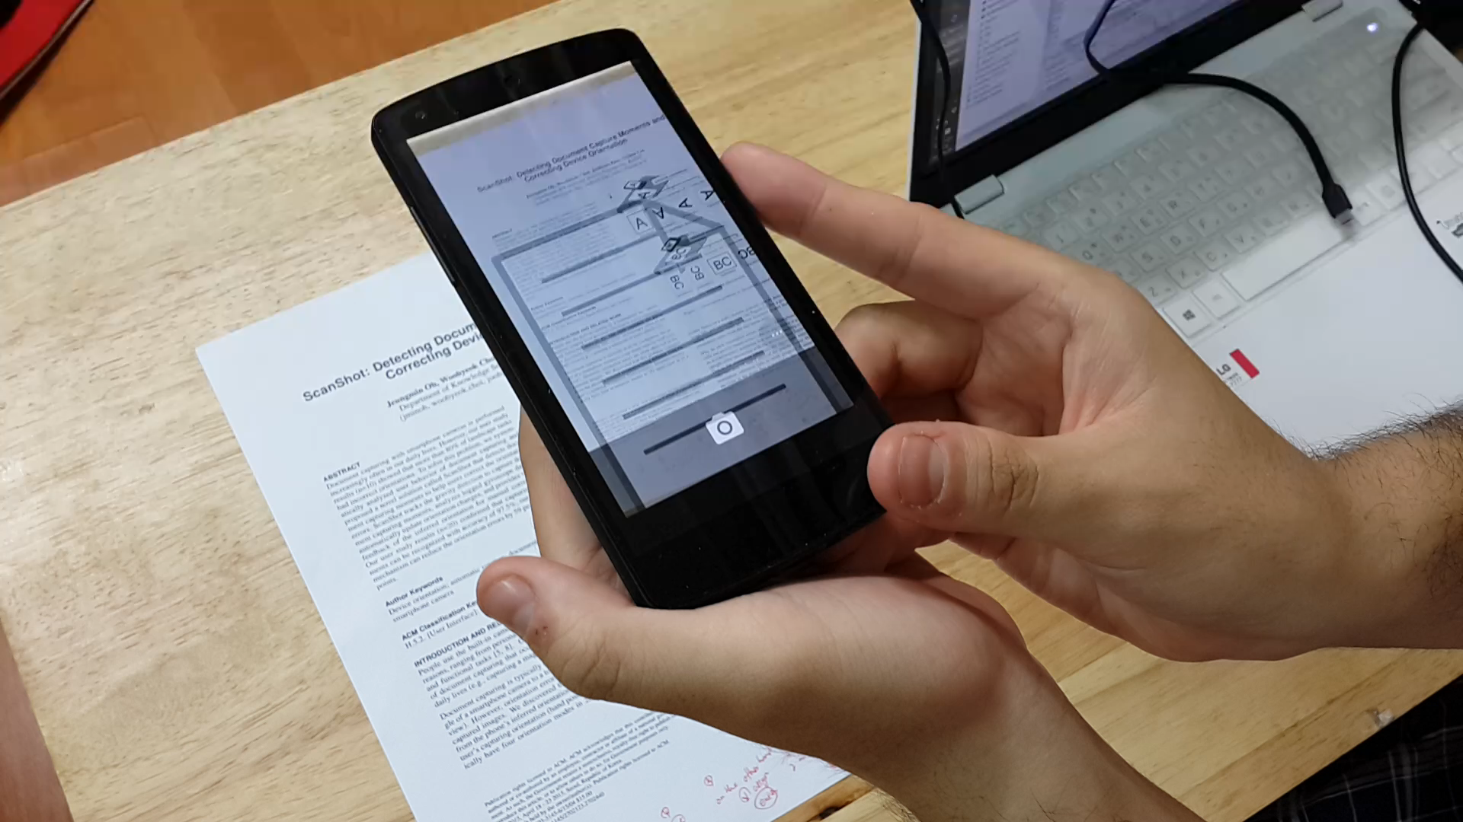
1. Detecting document
capture moments
2. Fixing an orientation error
by tracking rotation
3. Displaying an overlay indicator for manual correction
A
G
Acc-Z
Accelerometer is used for detecting document capturing behavior
Notes:
- As the first step, ScanShot checks gravity force on the Z-axis of accelerometer to determine if the user is capturing document or not.
- After a user spots an area to capture through preview screen, the Z-axis value approaches to gravity value and the device’s movement gets stabilized.
- (Click) In this video, you can find how the document capture mode is detected by ScanShot. If the tilt angle becomes close to the document, the document capture moment is activated.
- Internally, ScanShot sliced the sensor values into 2-second windows and check whether average and standard deviation is within certain threshold or not.

Slide 12
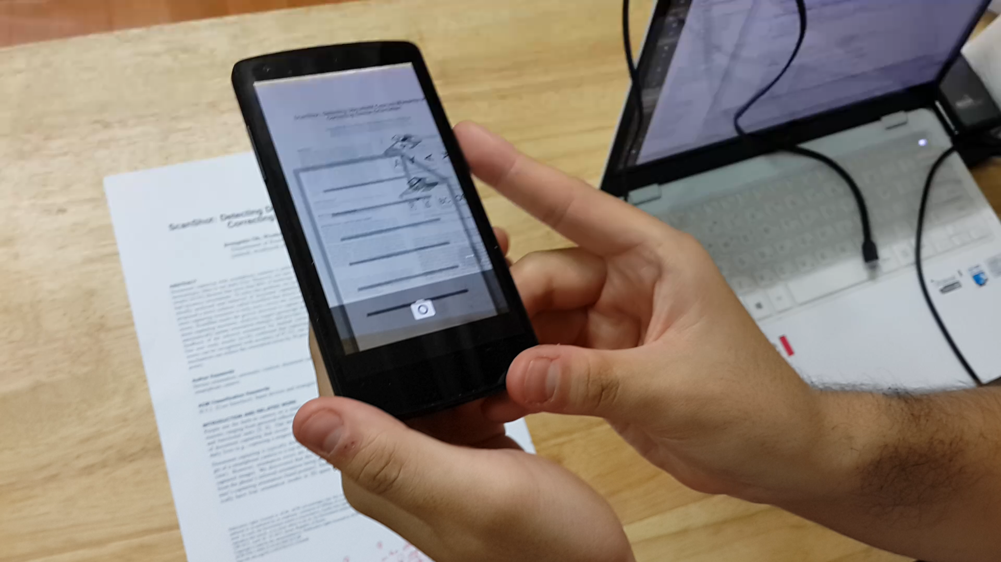
1. Detecting document
capture moments
2. Fixing an orientation error
by tracking rotation
3. Displaying an overlay indicator for manual correction
Gyro-Z
A
Gyroscope is used for tracking rotation to fix an orientation error
Notes:
- As a second step, once the document capture moment is detected, ScanShot applies newly calculated orientation to the system.
- The new orientation is computed by integrating gyroscope values, which contain rotation information.
- (Click) If the integral value is higher or lower than certain threshold, ScanShot changes the orientation.
- From our user experiment, we set this threshold as 29 degree.
- [We only use two orientation modes because users are all observed as using only two instead of four.]

Slide 13
1. Detecting document
capture moments
2. Fixing an orientation error
by tracking rotation
3. Displaying an overlay indicator for manual correction
-0.59
-0.89
ScanShot successfully reduced erroneous orientations
in the landscape document capturing task
Notes:
- The evaluation showed that ScanShot reduced orientation errors significantly by 59 percentage points for landscape documents.
- Portrait task has similar result, which can be found in the paper.
- (Click) We further improved this accuracy by activating ScanShot ahead of launching the camera app.

Slide 14



1. Detecting document
capture moments
2. Fixing an orientation error
by tracking rotation
3. Displaying an overlay indicator for manual correction
(a) overlay with
incorrect orientation
BC
A
BC
A
(b) overlay with
correct orientation
ScanShot displays overlay screen if needed
Notes:
As a final step, we display an overlay indicator for manual correction if needed.
One interesting finding from our user study was that users were mostly unware of why this problem happens because the orientation icon is hard to recognize.
We use paper metaphor overlay image to help user to easily recognize current orientation. And our participants were quite satisfied with this user interface.

Slide 15
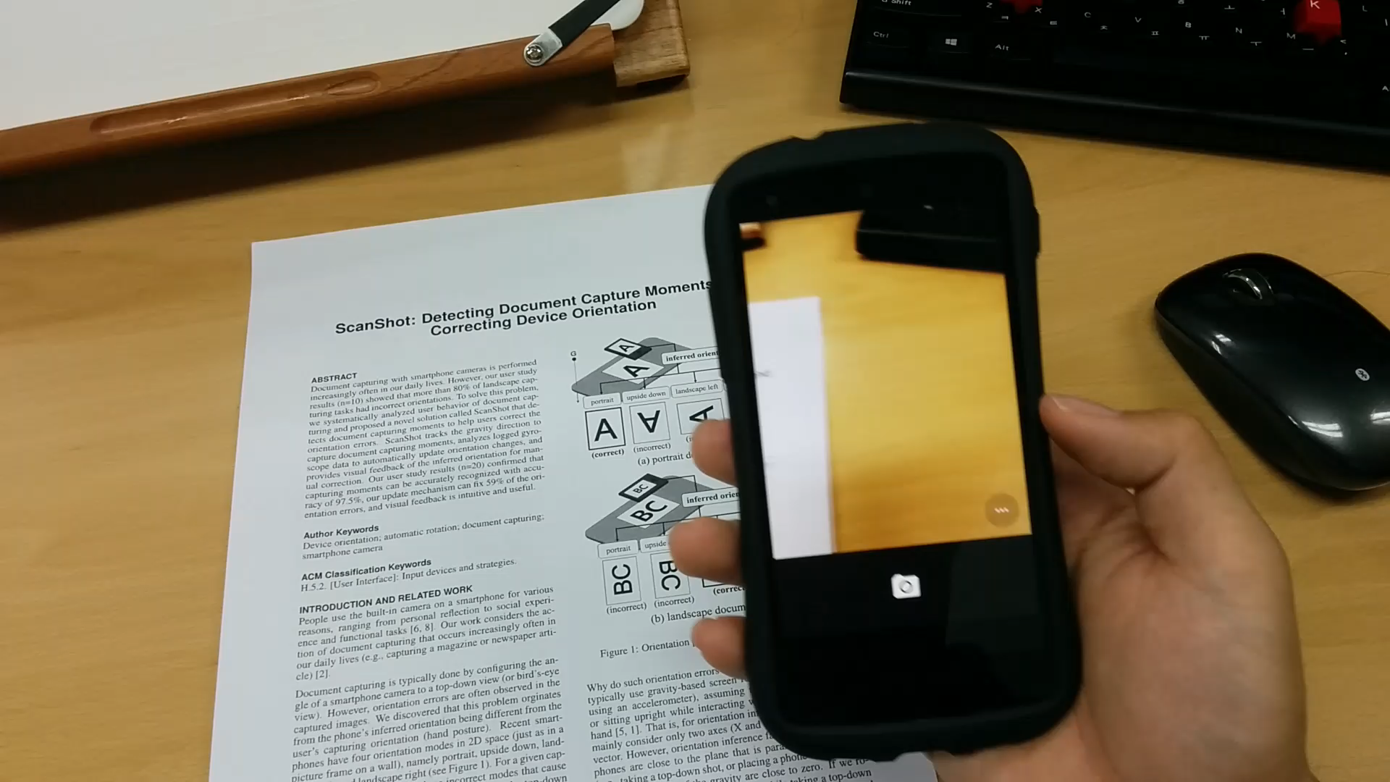
Demo Video
Notes:
Here’s demo of how our prototype works.

Slide 16
Q&A
Notes:
Thanks for paying attention and I’ll be happy to answer your questions.

Slide 17
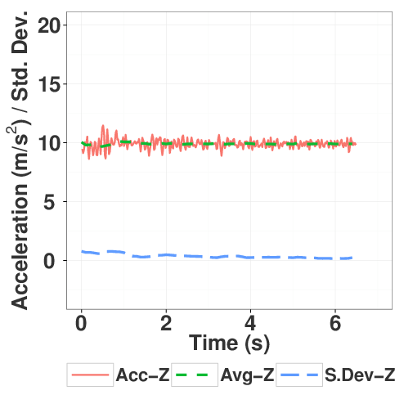
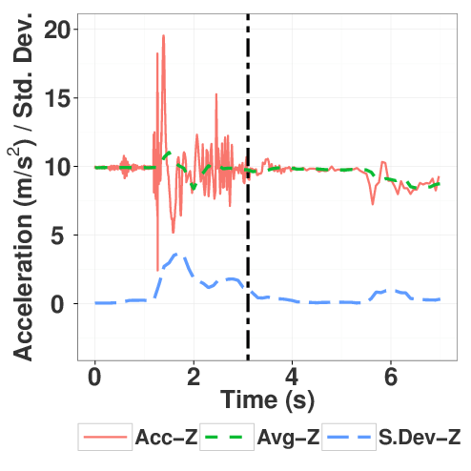
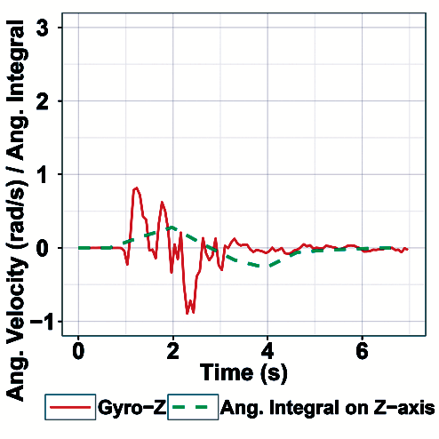
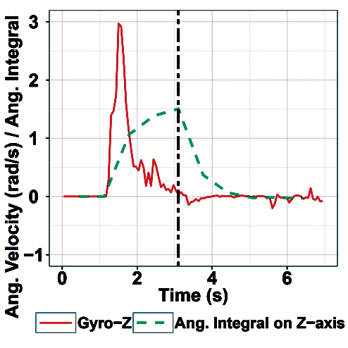
Sensor data
Portrait, no rotation
Landscape, rotation
Portrait, no rotation
Landscape, rotation
Accelerometer
Gyroscope

Slide 18
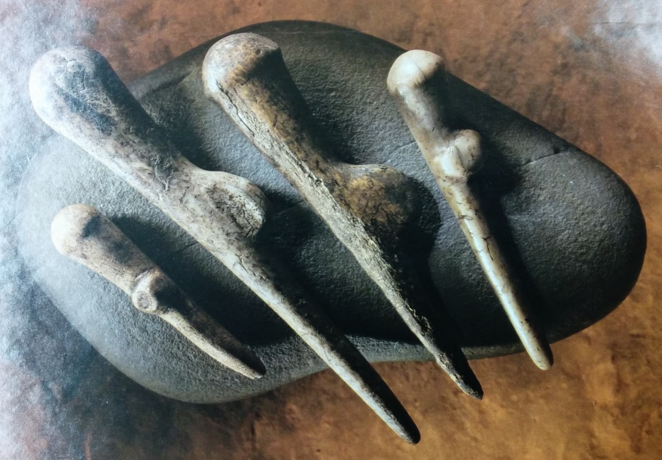
CV-based approach

Slide 19
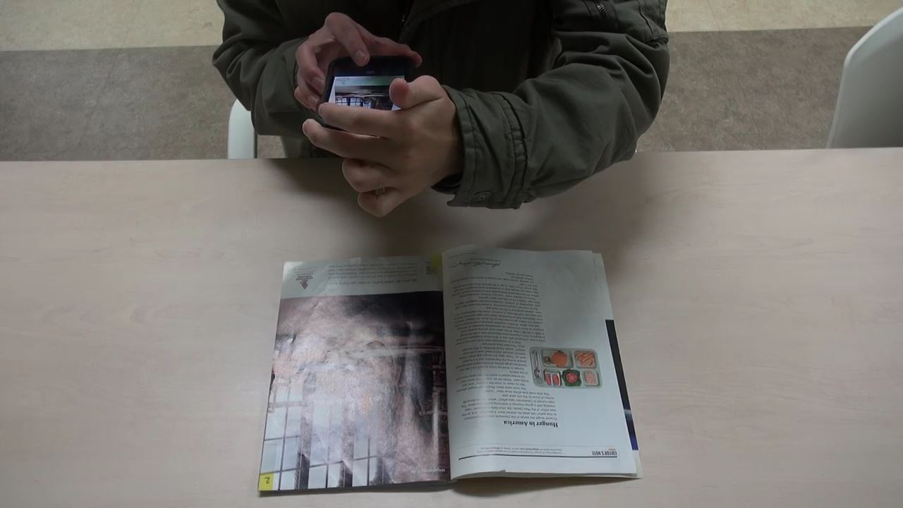
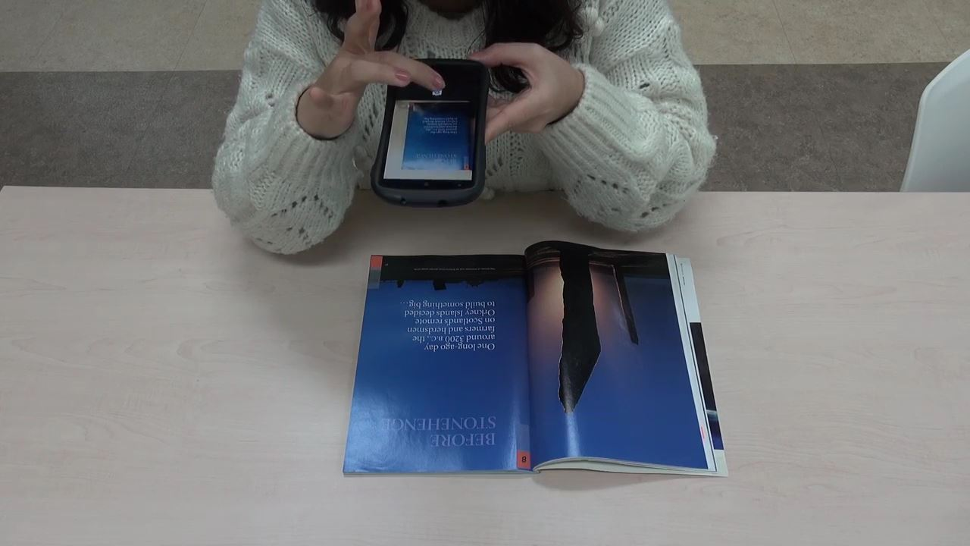
Grips for document capturing task
External H/W

Slide 20
Variation of overlays
A
A
This is a
document
(a) overlay with
correct orientation
(b) overlay with
incorrect orientation

Slide 21
Gyro-Z
A
Acc-Z
G

